Slide 1
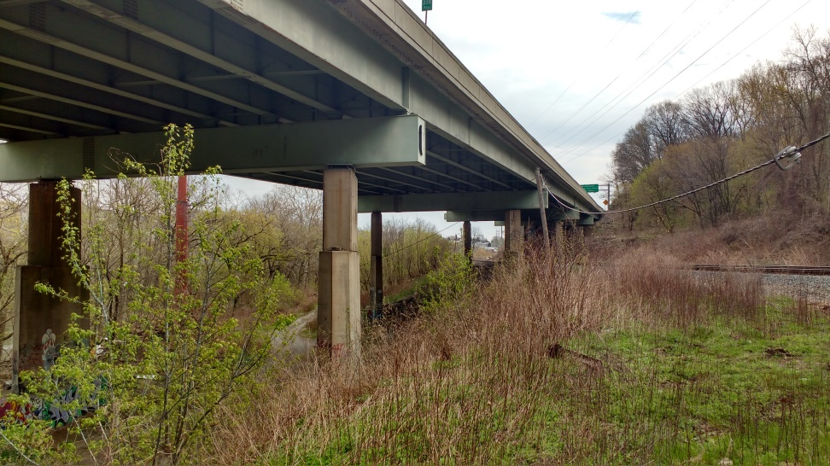
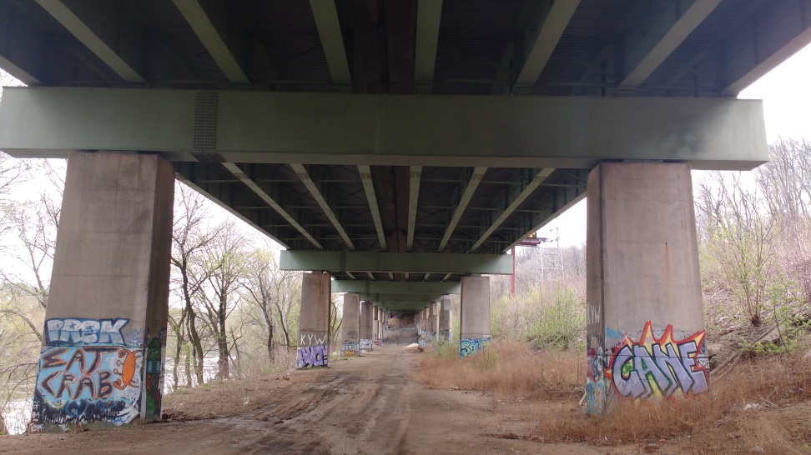
I76 Vibration Study
2 Stage Test
1st Phase – Longitudinal Survey
Instrument Piers
Lateral Acceleration
Short Duration
2nd Phase – Monitoring Section
Instrument Representative Section
Acceleration of Superstructure
Characterize Structure

Slide 2
Acceleration Instrumentation Plan
32 Acclerometers:
20 vertically oriented accels
6 transversely oriented accels
6 longitudinally oriented accels
Span 7
Span 8

Slide 3
Strain Gauge Plan. Objectives:
Estimate “Dynamic Amplification Factor”
Identify location of maximum response (controlling shape)
6 Strain Gauges:
2 Locations
1 centered on bottom flange
2 installed on web
Sampled at 100 Hz to capture dynamic effects
40% Span
Mid-span
14’
Span 7

Slide 4
Strain Gauge Plan. Objectives:
Determine how pier is being driven transversely
6 Strain Gauges:
2 Locations
Bottom flange locations capture out of plane
Web locations locate neutral axis and separate axial from bending force
Sampled at 100 Hz to capture dynamic effects
Span 7

Slide 5
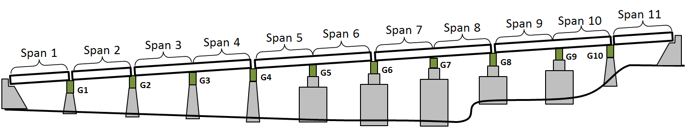

Slide 6
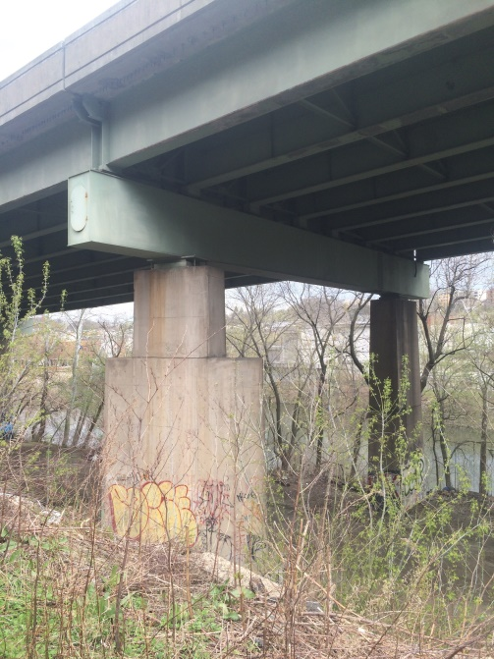
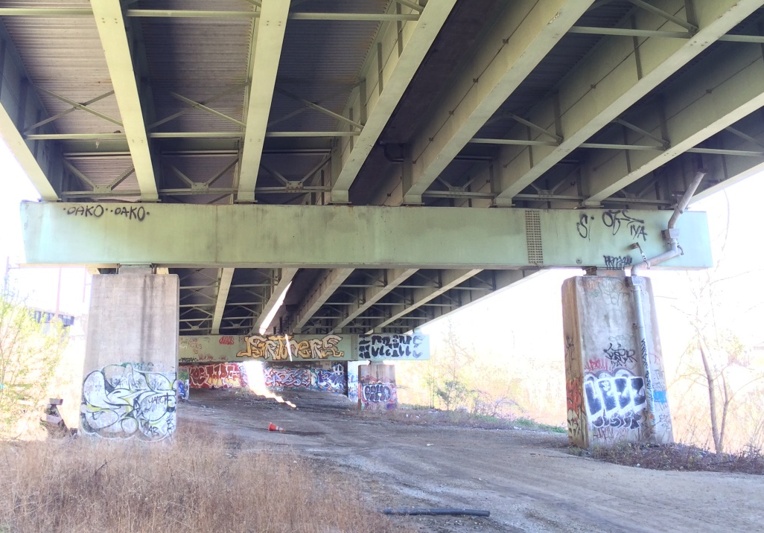
Phase 1
Span 7
Span 8
Span 9
Span 10
Span 4
Span 5
Span 6
Span 3
G10
G7
G8
G9
G4
G5
G6
G2
G3
Test Design to Avoid Traffic Control
4 Continuous Sections of interest
Accel. placed on side of piers (lateral)
Access provided with ladders
Record vibration for several hours
Determine “liveliest” section
If negligible difference:
Choose section most conducive to testing
Otherwise choose “liveliest” span

Slide 7
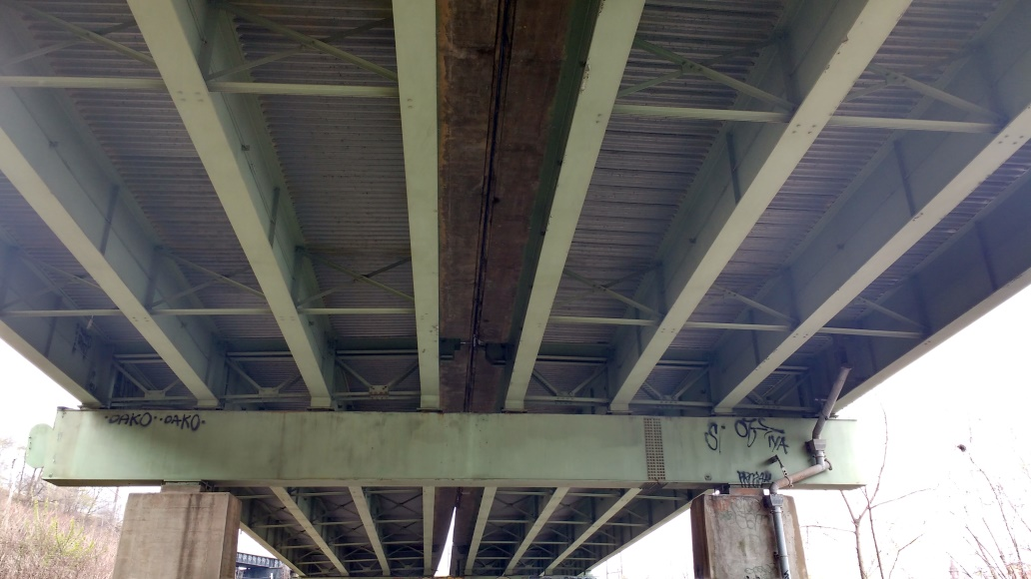
Phase 2
Extended Vibration Study
32 Accelerometers on Girders
Record for several days
Capture vibration characteristics
Monitor vibration amplitude
Correlate with traffic via video
St-ID with FE modeling
Identify possible methods to mitigate vibration discernable by public

Slide 8
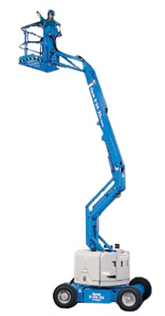
I76 Requirements
Phase 1:
Complete construction documents, inspection reports, CAD drawings
Phase 2:
Aerial Lift
2 days install
1 day breakdown
Power
Video camera capturing traffic
60 Feet Minimum

Slide 9
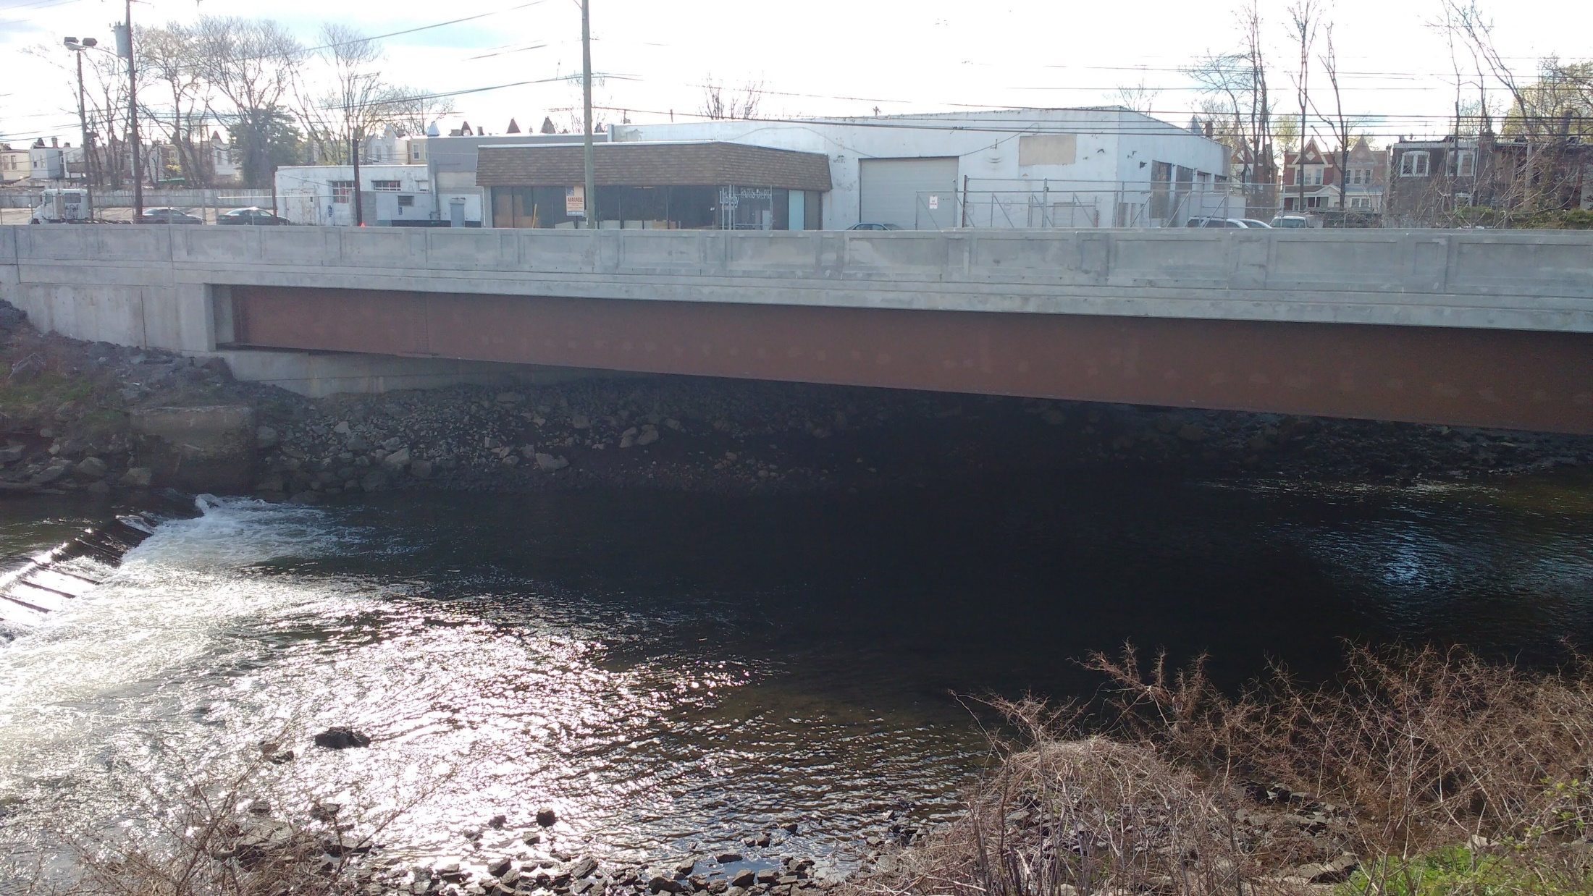
THMPR™

Slide 10
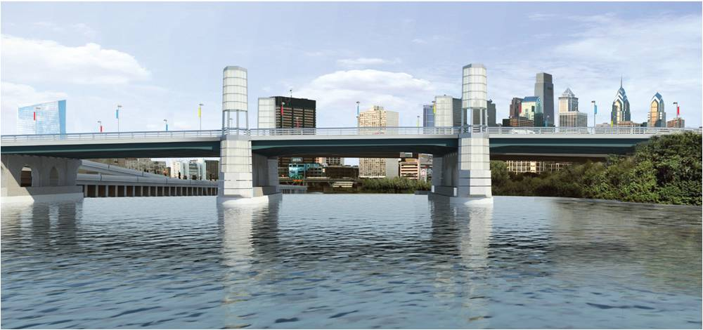
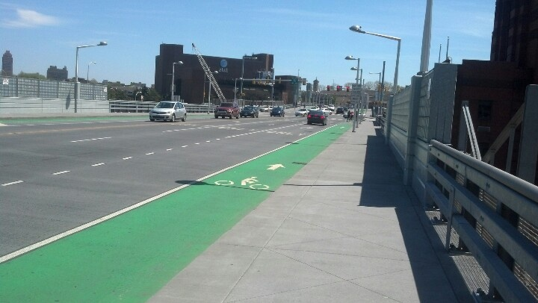

Slide 11
